Slide 1


University of Basrah College of Nursing
Growth and development Measurement
Second Lectures
Prepared by:- assist lec. Noor Salah Shreef

Slide 2
Essential Pediatric Nursing Steps
Understand Child Growth and Development
Knowing Communication skills with children and their parents
Encourage Child Health Promotion & Disease Prevention
Realize the methods of Caring for children & Culturally Sensitive Interactions

Slide 3
Why Is It Important to Assess Growth and Nutrition During the Physical Examination?
Growth measurements correlate directly to nutritional status and can
indicate whether a child’s health and well-being are at risk.
Calculating and tracking BMI provides vital information about
weight status and risk of overweight and obesity.
Measuring head circumference, especially within the first 3 years,
may identify neurologic abnormalities as well as malnutrition.

Slide 4
Head
Shape:
“NormoCephalic – Atraumatic
Lesions
Edema
Head: Important Points
Head Circumference (HC).
Fontanels : Anterior closes at 10-18 months, posterior by 2 months

Symmetry & Shape: Face & skull

Bruits: Temporal bruits may be significant after 5 years

Slide 5
Hair: Patterns, loss, hygiene, Lice specially in school aged child
 Sinuses: Palpate for tenderness in older children
 Facial expression: Sadness, signs of abuse, allergy, fatigue

Slide 6
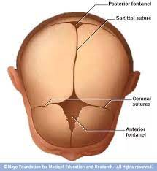
FONTANELS
 Fontanels, also known as soft spots, are spaces located at the areas where skull bones meet.
 Anterior Fontanel – located at the junction of the two parieted bones and fused front bones. It is diamond shape about 3cm long and 2-3 cm wide.
 It closes at 12 to 18 months of age

Slide 7
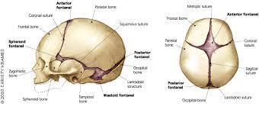
Posterior Fontanel – located at the conjunction of the parietal and occipital bones. Measures about 0.5 to 1 cm in length.
Begins to close at 2 months of the age . Fontanels are usually soft , flat and firm and it may be pulsate.

Slide 8

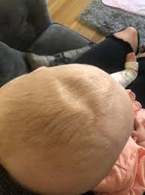

Abnormal Findings
Bulging fontanel – indicate increased intracranial pressure.
Sunken fontanel – indicate as sign of dehydration.
Very large fontanel – may indicate hypothyroidism

Slide 9
Eyes
Visual Acuity – usually at birth 20/150 to 20/190
Eye reflexes – Blink reflex when put the light or any thing near the child’s eye he or she should immediate blink.
Tears should appear from 3 to 4 months.
Any abnormalities in pupils , sclera, conjunctiva, and discharge.

Slide 10
Ears
Position – tope part of the pinna should be in line with outer canthus of the eye.
It is normal to find ears flooded over the side of the head.
Children should turn to sound.
Minor abnormalities may be signs of renal Problems.

Slide 11

Nose
Shape – symmetrical in placement and normal size.
Placement – located midline on the face.
Air follow – close child’s mouth and check it.
Drainage – assess the discharge.

Slide 12
Mouth
Lip color – normally pinkish see when child crying.
Mouth Movement – Mouth and jaw should move equally.
Tongue - should be symmetric in shape and free movable.
Feeding Reflex – rooting , sucking , gagging and extrusion reflex should be present.
Teeth – check the number and position

Slide 13
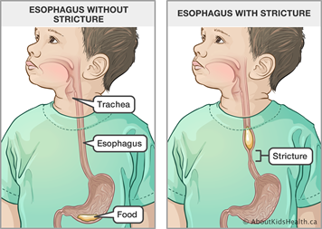
Abnormal Findings
Cleft lip and palate.
Asymmetry in lip movement indicate 7th cranial nerve damage.
Lip cyanosis – indicates respiratory distress
Excessive saliva - indicates may esophageal atresia or tracheoesophageal fistula.
Tight Frenulum refers to tongue lie

Slide 14
Neck
Neck lengthens at 2 to 3 years old
Infant’s heal usually not strong enough to support the head.
The thymus gland usually enlarged due to rapid growth of the gland tissue.
Abnormal Findings
Thyroid gland – enlarged may be goiter or hyperactive thyroid.
Limit neck movement- main signs of meningitis.
Rigidity of the neck – may be injury of the neck muscles.

Slide 15

Chest
Shape – looks small in relation to head in infants.
Shoulders are sloping.
Heart rate – left side
Breathing rate with abdominal muscles should check.
Abnormal Findings
Chest retraction – respiratory distress
Bulging of the chest – pneumothorax.
Malformation – funnel shape
Displacement of the heart toward the right – diaphragmatic hernia

Slide 16
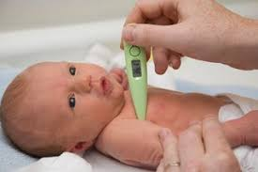
Vital Signs
1- TEMPERATURE
newborn temperature is 36.3 c - 37.2c
Heat regulation is the important task in the newborn nursing care they are easy to loss body temperature due to immaturity of temperature regulating system, little amount of subcutaneous fatty tissue and large body surface.
The method of choice when obtaining the temperature of the children below 6 years old is the axillary because it is safer and more accessible. The nurse should put the thermometer in the axilla for 5 minutes.

Slide 17
RESPIRATORY RATE
Range from 30 to 60 breaths per minute
Respiratory rate (RR) shows down during the infancy period.
The nurse need to check the abdominal and the diaphragmatic area the chest and abdomen should rise at the same time during the infancy period.
Signs of Respiratory Distress:
Nasal flaring.
Chest retraction, indrawing of the chest when breathing.
See-saw respiration , indrawing of the chest and rising of the abdomen during inspiration.
Cyanosis of the hand and feet.
Respiratory grunting – noisy respiration. Wheezing

Slide 18
HEART RATE
Full term infants have heart rate that ranges from 120 to 150 bpm.
Rhythm is char rate increasing with inspiration and decreasing when expiration.
Heartbeat in newborn is often irregular.
Nurse need to take apical pulse and respiration while the child sleeping to
obtain accurate results.

Slide 19
Pediatric Vital Signs – Normal Ranges
Vital signs | Infant | Toddler | School age | Adolescents
Heart rate | 80- 150 | 70- 110 | 60-110 | 60-100
Respiratory rate | 24-38 | 22-30 | 14-22 | 12-22
Systolic blood pressure | 65-100 | 90-105 | 90-120 | 110-125
Diastolic blood pressure | 45 - 65 | 55-70 | 60-75 | 65-85

Slide 20
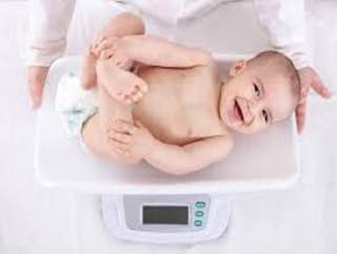
Weight
A full term baby on an average weighs 3.5 kg.
Weight loss in first few days: 5% - 10% of birth weight
Return to birth weight: 10 days of age
Doubled (twice) by 6 months
Tripled (thrice) by one year.
Quadrupled (4 times) by 2 years.
Average weights:
•3.5 kg at birth
•10kgat1yr
•20kg at 5 yr
•30kg at l0yr

Slide 21
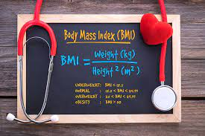
Calculate BMI
The metric formula to calculate BMI is weight ÷ (height x height).
Measure the child's weight in kilograms (not grams).
Measure the child's height in meters.
Calculate the BMI by dividing the weight

Slide 22
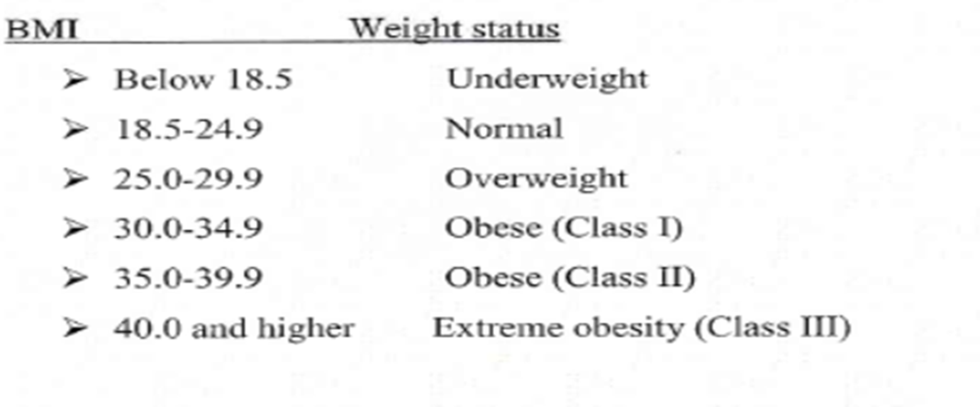
Normal value of BMI for children

Slide 23
Height:
1. The average child length is 50 cm at birth,75 cm at 1 yr and 87 cm at 2 yr.
2. At age 4 yr, the average child is 100 cm tall (double birth length)
3. So, body ht. increases by about 50% at the end of lst yr than it was at birth, and 100 cm at 4thYr.
Average annual height increase: 5-7 cm between age 4 yr and puberty. For infants, the measure of linear growth is length, taken by two examiners (one to position the child) with the child supine on a measuring board (Infantometer).
Infancy and Early Childhood (0–2 years);-Until they can stand securely (age 2 years), measure infants lying down in a supine position on a measuring child frame or an examining table.

Slide 24
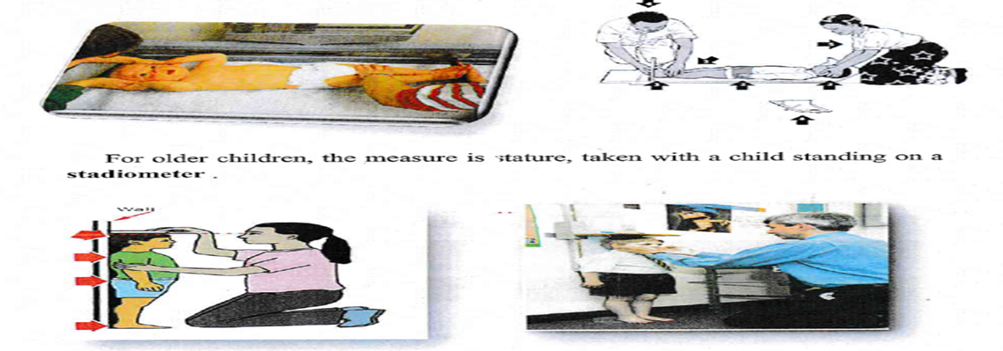
The child should stand erect with bare and closed feet, the external auditory meatus at the level of lateral canthus and all aspects of back should be in touch with the wall as much as possible.

Slide 25
C. Head Circumference:
Measured from the supraorbital ridge in front to the farthest point of the occiput in back i.e. Occipito - Frontal Circumference (OFC).tool used to measure the HC is tube measure
Range HC: 33 -35 cm at birth (13- 14 inches) By 1 yr it increases 12 cm to become 47 cm OFC increase in the 1st year of life.
35 cm Birth
0-3 mo 2 cm / mo
3-6 mo 1 cm / mo
6-12 ½ cm / mo
1yr 47 cm

Slide 26
We should note the following changes in the head circumference:
At birth HC may be equal or greater than Chest Circumference CC due to molding.
After 2 to 3 days HC is greater than CC by 2 to 3 cm.
After six months HC is equal CC.
After one year HC is less than CC .
Abnormal Findings
HC less than 32 cm is indicative of Microcephaly
HC is 37cm and grater than CC is indicative of neurologic involvement such as Hydrocephalus.

Slide 27
Chest Circumference
Normal CC range from 30.5 to 33 cm ( 12 to 13 inches)
Usually 2 cm less than HC.
The CC is measured at the level of the nipple using a tape measure .
Abnormal Findings
The CC less than 30 cm indicates prematurity.
An enlarged heart may make the left side of the chest larger

Slide 28
Abdominal Circumference
Abdominal Circumference (AC) is approximately the same as chest
circumference.
It is measured just above the level of the Umbilicus.
Abnormal Findings
AC is not routinely measured unless there is a suspicion of abdominal distention due to obstruction in the gastrointestinal tract.

Slide 29
Growth Chart
The growth chart is a visual display of child's physical growth. Growth Charts are used to compare child's height, weight and head circumference against children of same age.

Slide 30
Important or uses of growth chart:
1. Growth monitoring: main use is growth monitoring of child.
2. Diagnostic tool: for mortality, morbidity and health status.
3. Planning & policy taking: by grading malnutrition.
4. Educational tool: mother can be educated regarding care of her child
5. Tool for action: it helps the health workers to determine type of intervention needed.
6. Tool for teaching: Growth chart also gives information like
Birth date & weight.

Slide 31
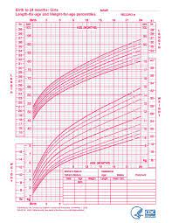

Slide 32
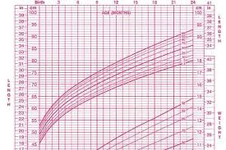

Slide 33
3. Denver Developmental Screening Test I and II (DDST)
1. The most widely used test for screening developmental problems in children.
2. Administered to children from birth to 6 years.
3. Assesses Development
4. Not An IQ Test
5. Ages to Assess

Slide 34
DDST II includes four areas or sector:
1. Personal-Social: 25 items
•Getting along with people and caring for personal needs.
2. Fine Motor-adaptive: 29 items
•Eye hand coordination, manipulation of small objects, and problem solving
3. Language: 39 items:
• Hearing, understanding, and using language
4. Gross Motor: 32 items:
•Sitting, walking, jumping
Time 15 – 20 Minutes.

Slide 35
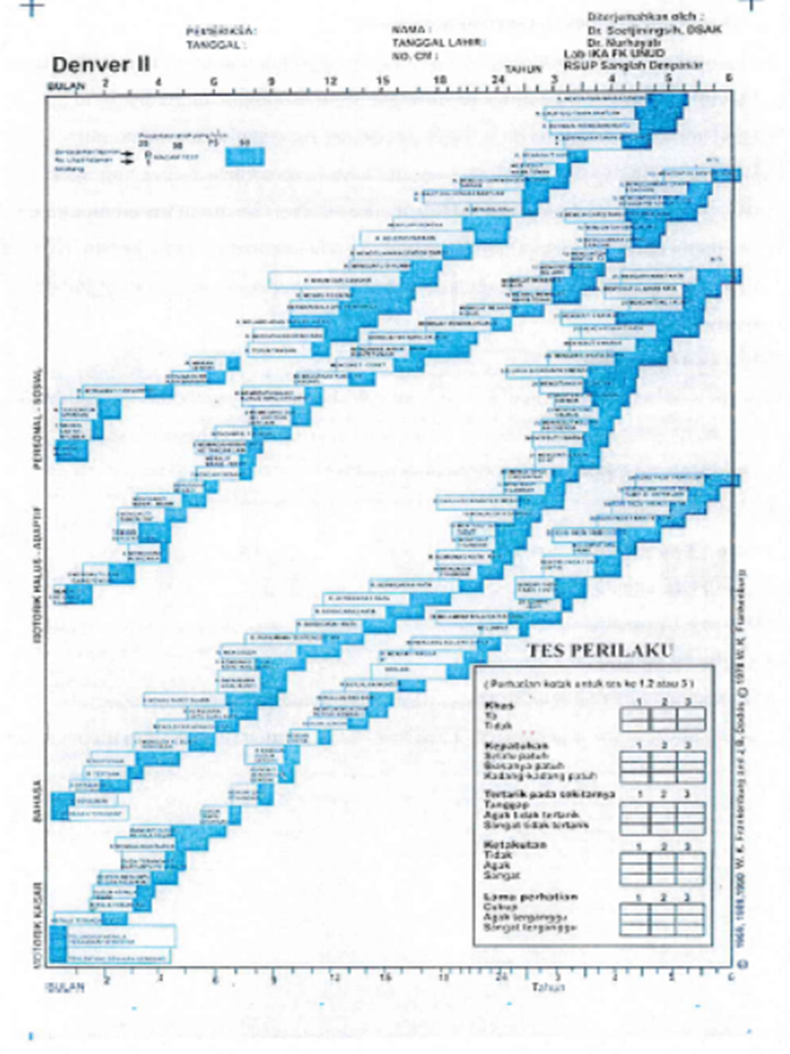

Slide 36
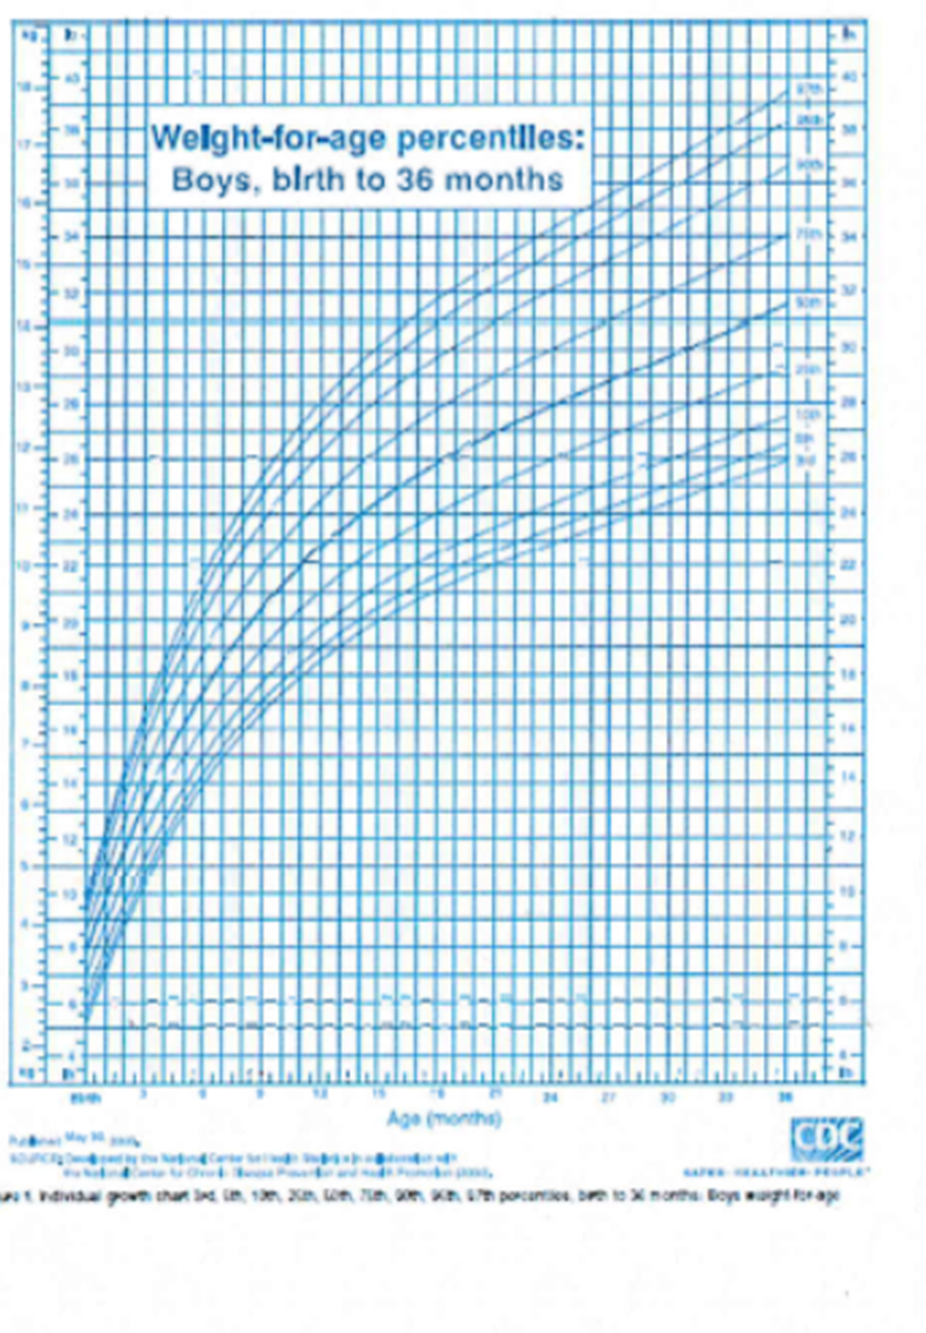

Slide 37
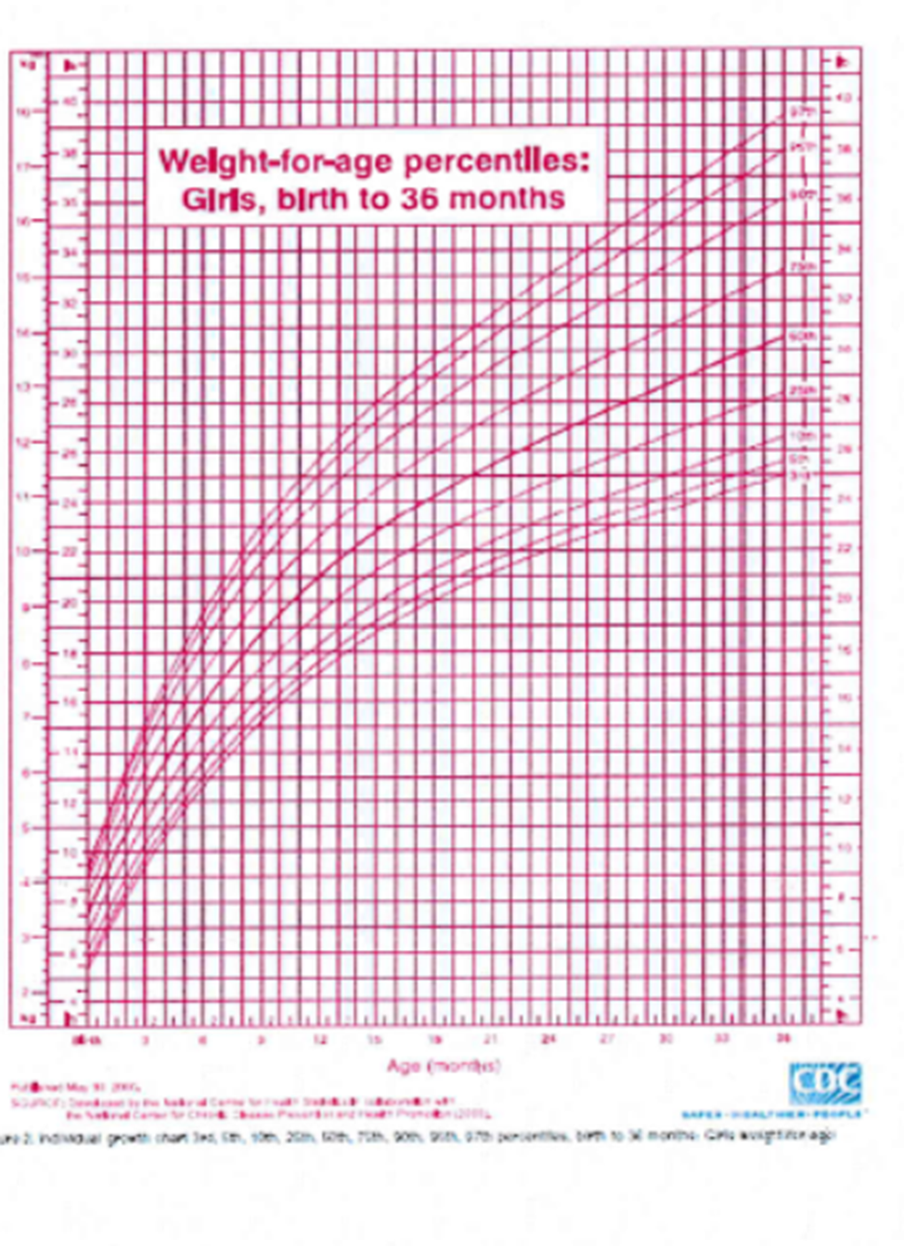

Slide 38
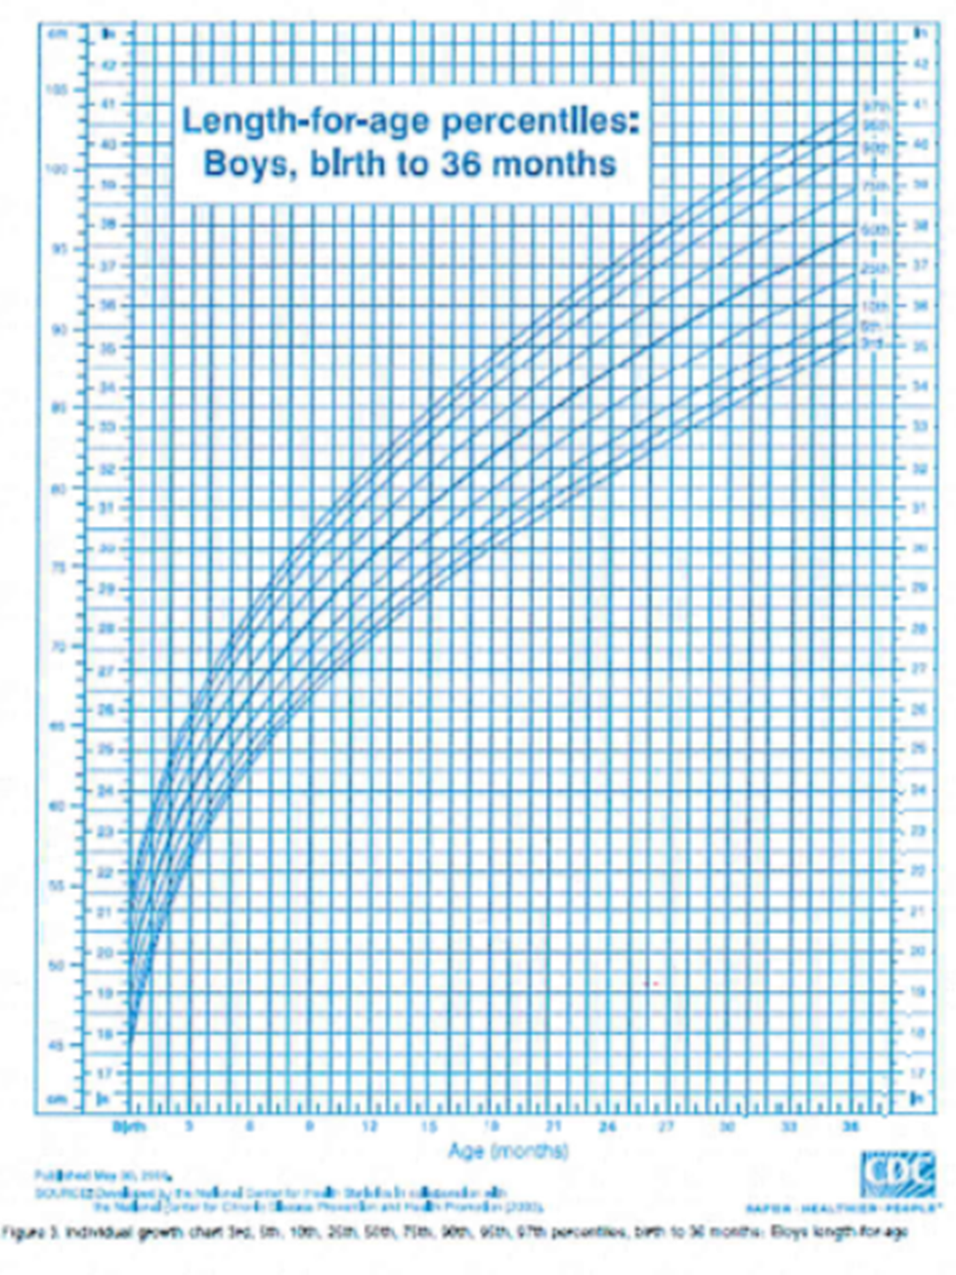

Slide 39
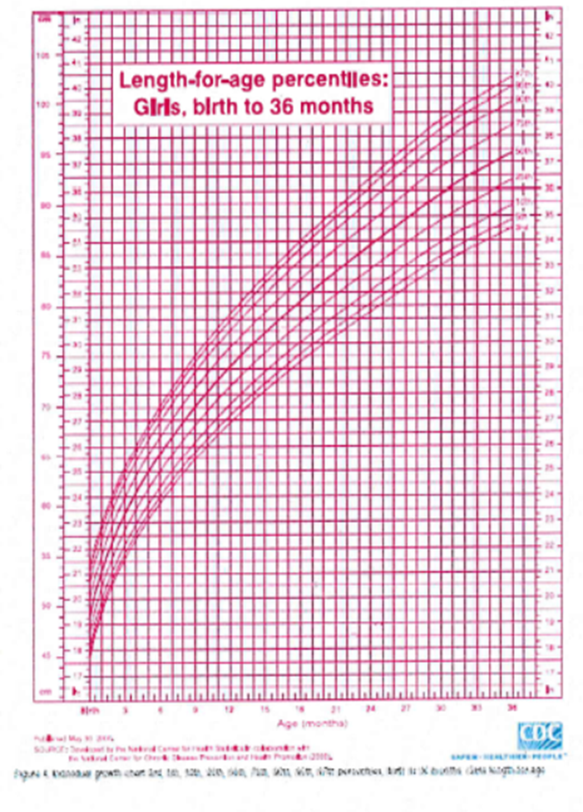

Slide 40
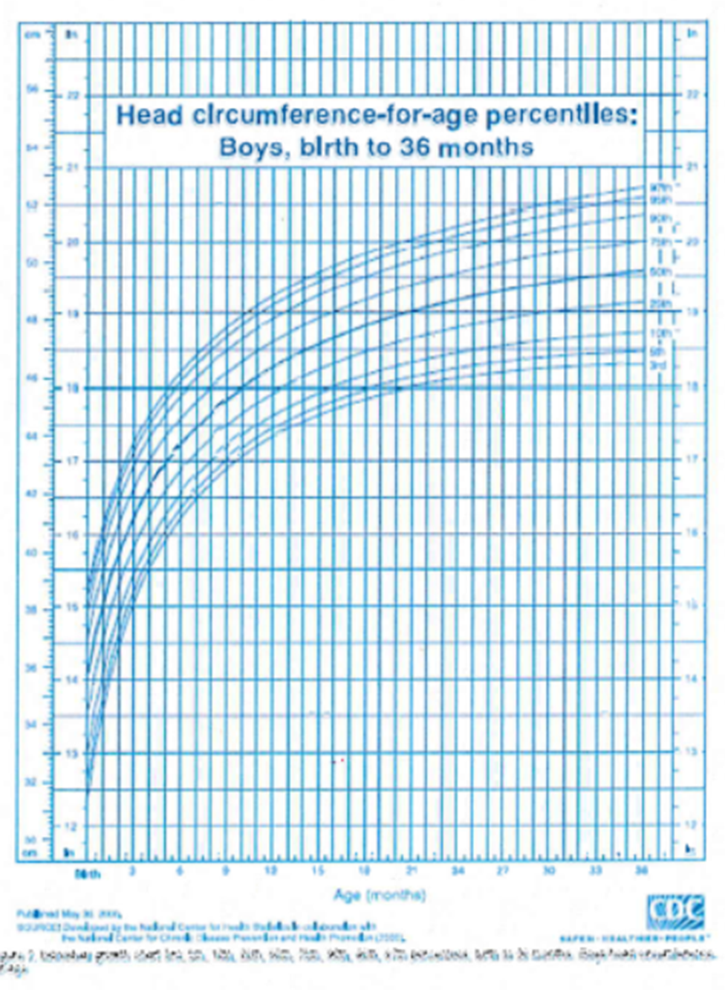

Slide 41
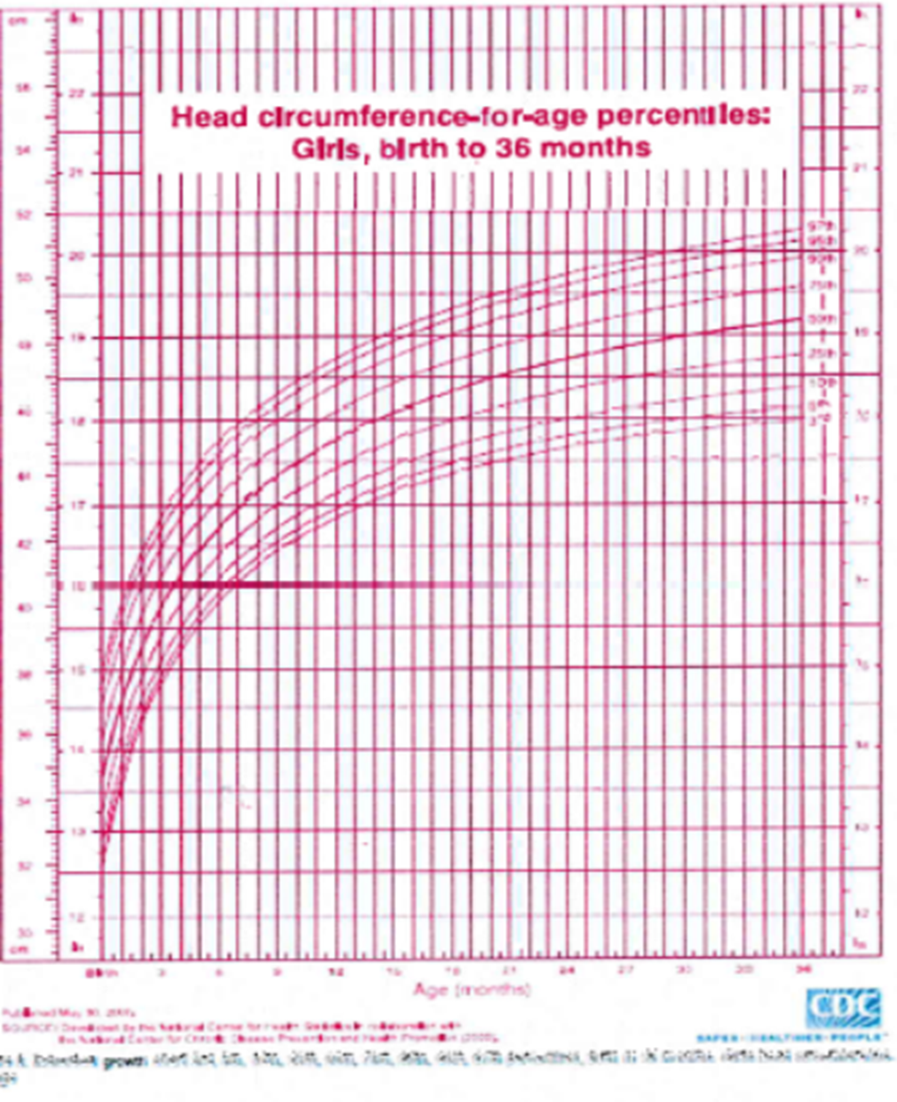

Slide 42


